Slide 1
Welcome to World History
Fall 2019

Slide 2
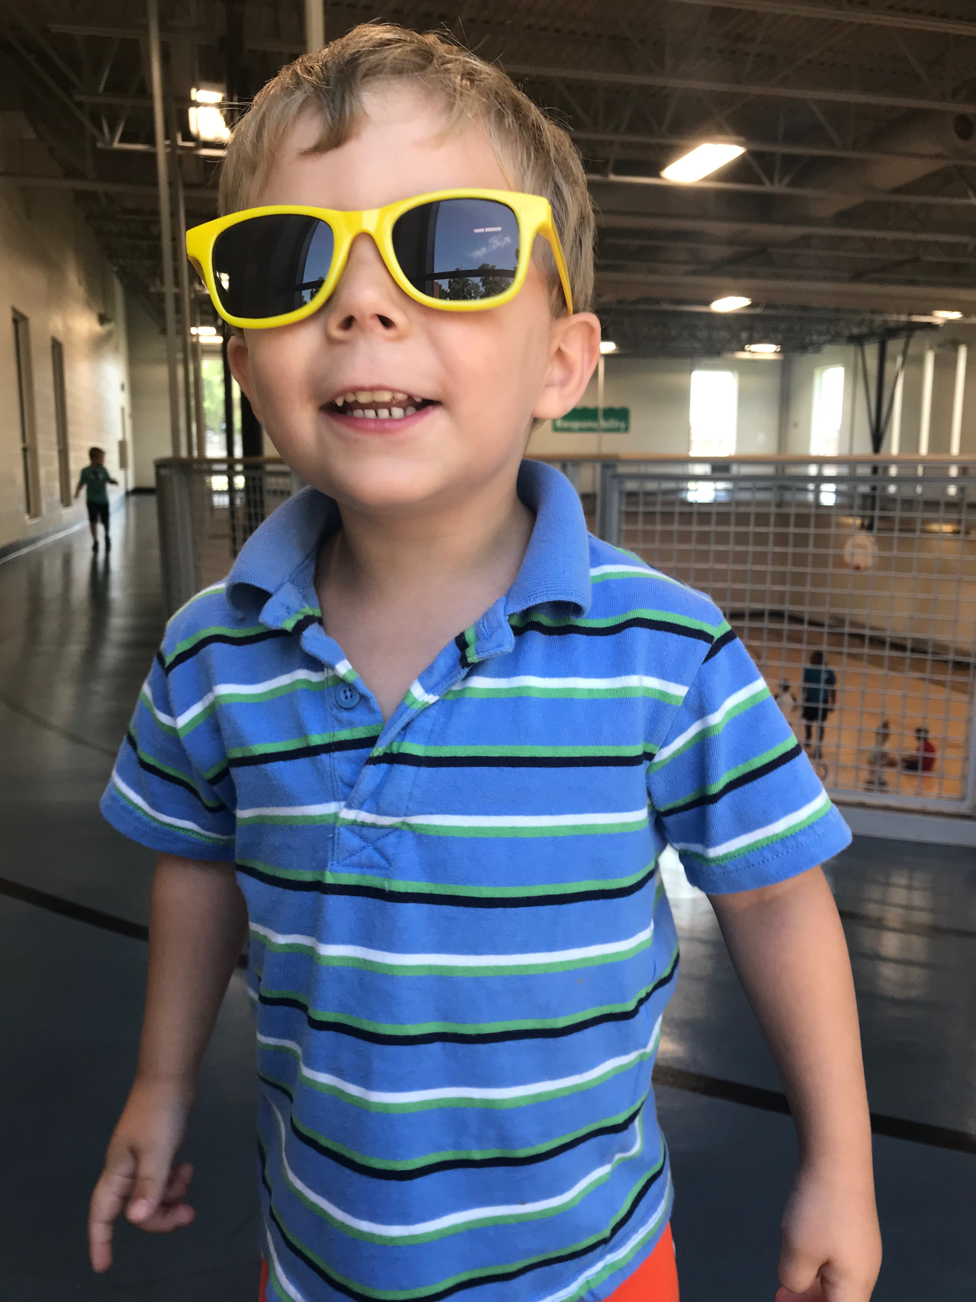
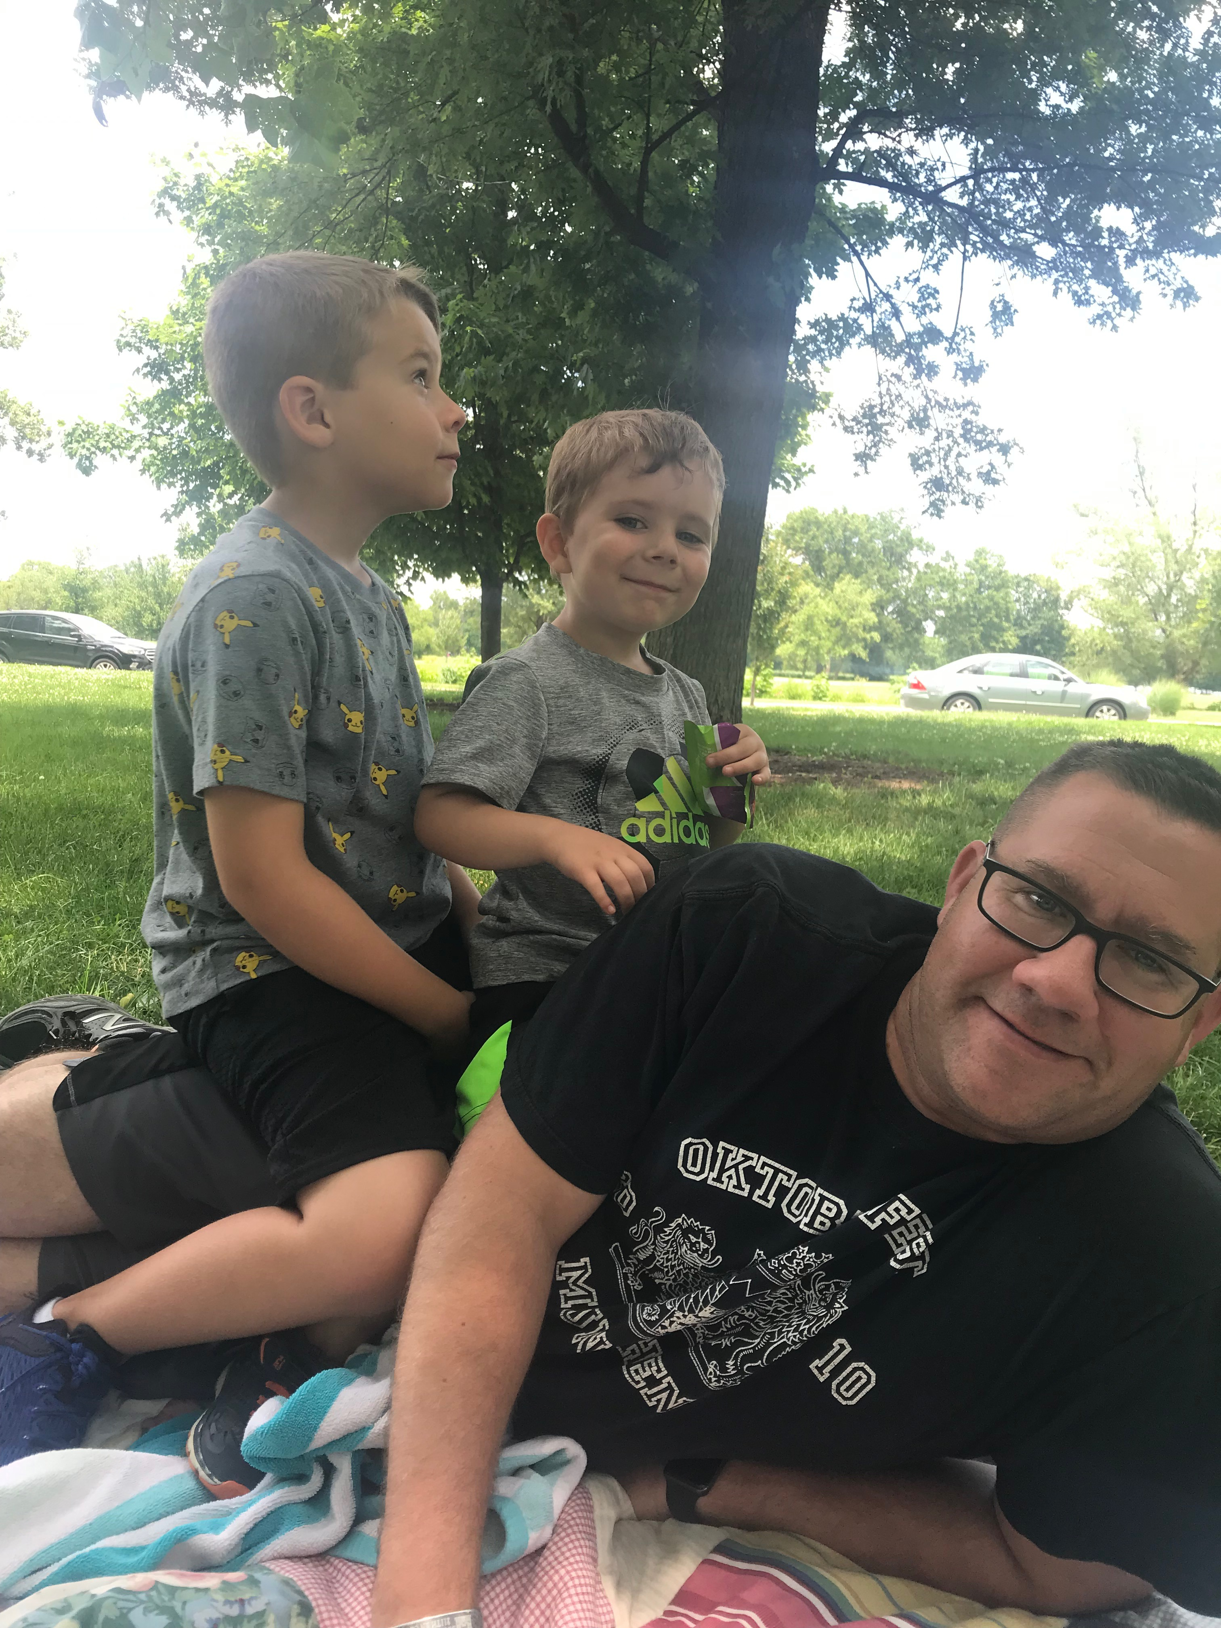
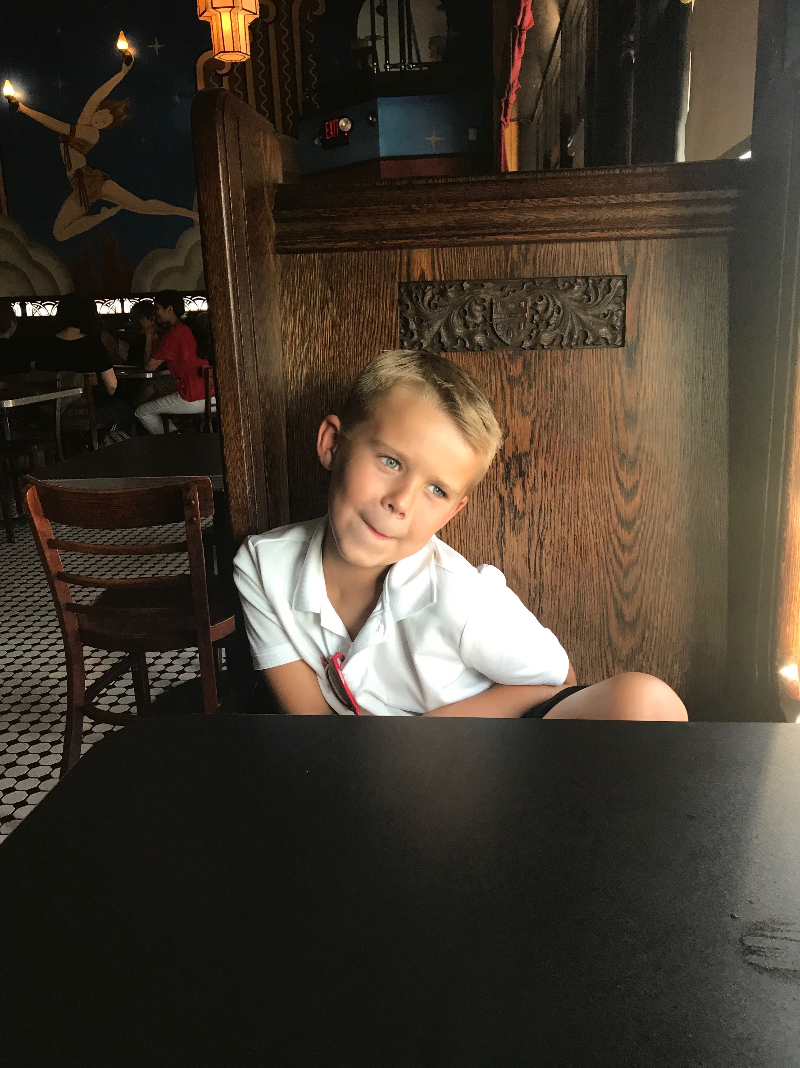
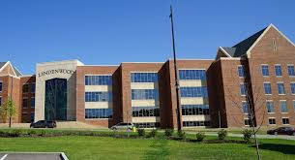
Who is Mr. Paluczak?

Slide 3
What will World History be like?
Student-centered learning
Activities/discussion instead of lecture
Historical Thinking Skills
Analyzing Evidence
Comparison
Argumentation
Contextualization and Synthesis
In order for you to practice these skills, YOU need to do the work
Read and complete HW
How can you succeed?
Complete the HW
Organize your notes and in class assignments
Review Guide
Participate in class and be respectful

Slide 4
Classroom Procedures
Check Board
Intro to class
Review
Activity
Exit Slip/Explain HW

Slide 5
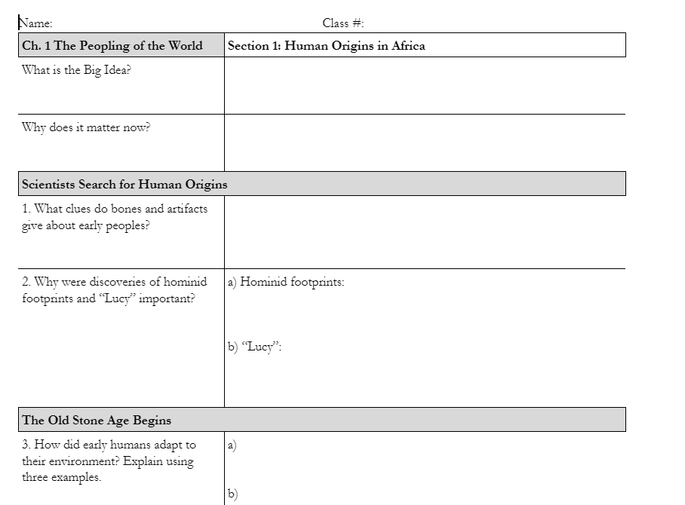
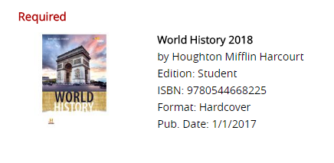
Formative Assessments
Found on weebly
Must be complete to receive full points

Slide 6
In your mind, which quote describes “history” the best?
“Nothing capable of being memorized is history.” –RG Collingwood
“History is not the accumulation of facts, but the relation of them.” –Giles Lytton Strachey
“The essential matter of history is not what happened, but what people thought or said about it.” –Frederic William Maitland
“The past does not repeat itself, but it rhymes.” –Mark Twain

Slide 7
“Nothing capable of being memorized is history.”
–RG Collingwood

Slide 8
“History is not the accumulation of facts, but the relation of them.”
–Giles Lytton Strachey

Slide 9
“The essential matter of history is not what happened, but what people thought or said about it.” –Frederic William Maitland

Slide 10
“The past does not repeat itself, but it rhymes.” –Mark Twain

