Slide 1
Two Chinas: Rural and Urban Divide
Day 6: Students will learn how China’s development has created deep inequalities between the urban and rural populations.

Slide 2
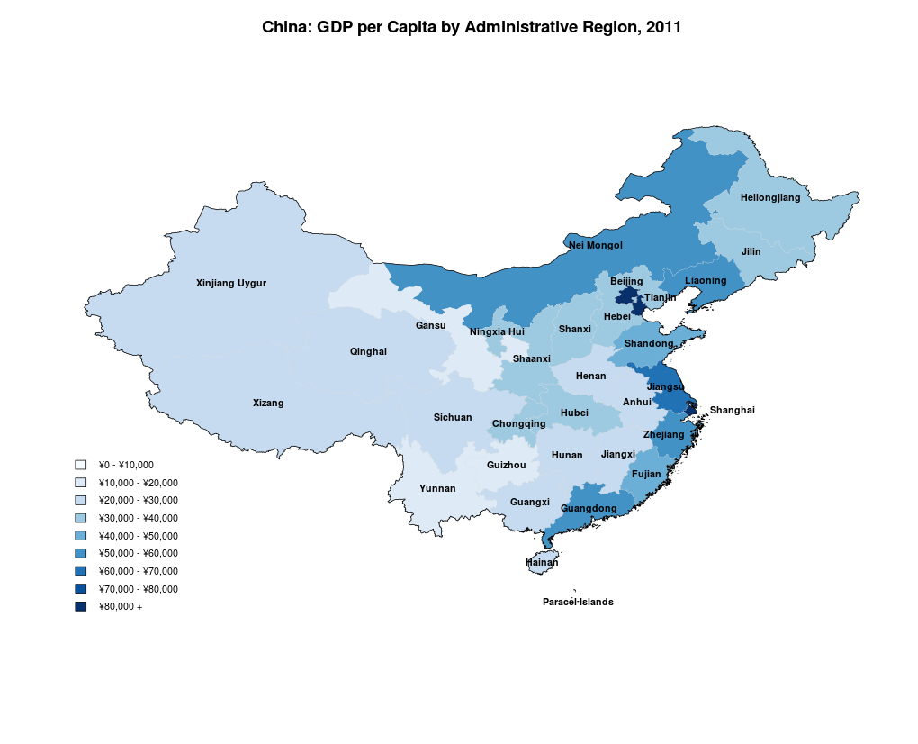
Inequalities
China is still a developing country that has very high levels of inequality between urban areas and the rural countryside.
Eastern cities have a much higher standard of living than do western provinces.
Notes:
http://genedan.com/tag/plot-heat-r/

Slide 3
Situation Factors
Due to its access to the Pacific Ocean most of the industrial and economic investment has occurred in the Eastern Provinces.

Slide 4
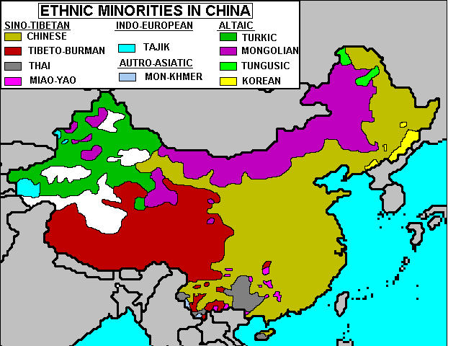
The West
The Western provinces are disproportionately populated by minority groups who rely on small scale farming for survival.
15 year difference in life expectancy between the East and West.
Notes:
http://www.chinatouristmaps.com/china-maps/ethnic-minorities-in-china.html

Slide 5
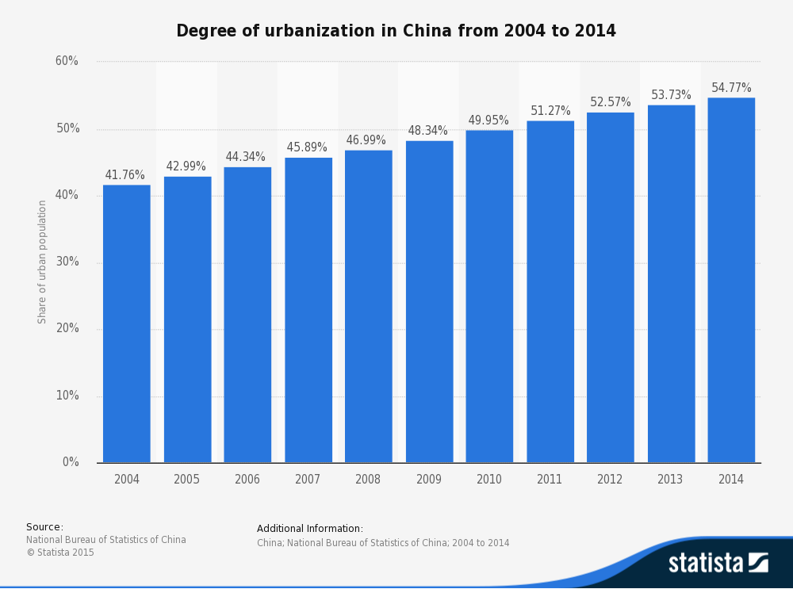
Urbanization
Millions of Chinese have migrated to Eastern cities in search of jobs and a better life.

Slide 6
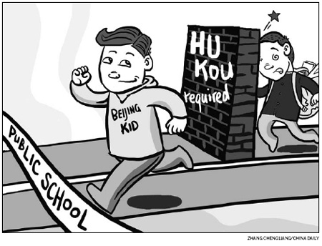
Hukou System
The government’s hukou system identifies the province of one’s birth.
If you migrate outside of your province you may be ineligible for important gov’t services. (i.e. schools and hospitals)
Notes:
http://www.chinadaily.com.cn/cndy/2010-04/16/content_9737770.htm

Slide 7
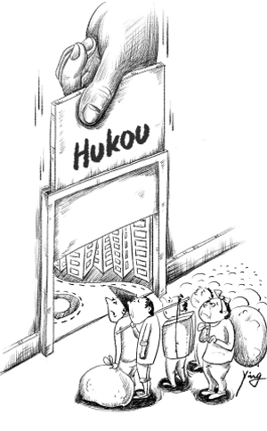
Underclass
The hukou system makes life very difficult for urban migrants who are often treated like second-class citizens in their own country.
https://www.youtube.com/watch?v=XGIvVXVmnss
Notes:
http://usa.chinadaily.com.cn/2010-03/23/content_11017083.htm

Slide 8
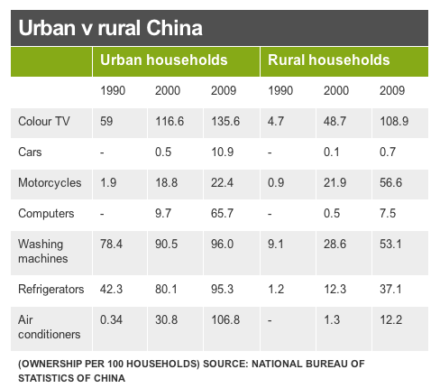

Slide 9
