Slide 1
Overpopulation in China
Day 5

Slide 2
“Tackling Overpopulation” HW
Answer these questions in your notes with a partner
What were the problems with China’s One-Child Policy?
What is the author’s main argument?

Slide 3
What is the One-Child Policy?
China’s One Child policy is a policy that the Chinese government introduced in 1979 to try and solve the problem of overpopulation.
It’s main purpose was to make sure that China could support its large population with facilities such as healthcare, education, housing, good jobs and most importantly, food.
The aim was to reduce poverty and to improve overall quality of life for the people.
http://www.youtube.com/watch?v=H4OWJlyaHt0

Slide 4
For or Against?
Economic, Political, or Social Issue?
The country was severely overpopulated | Starvation was a major problem for the Chinese people | There is now a big gender gap with 60 million more men than women | Female infanticide* has increased since the 1980s *Infanticide: To kill a baby
Parents in China receive the cost of child care and medical expenses for their one child. | Both parents are able to work so they will be financially better off | Abortion rate has gone up as women are pressured if pregnant for a 2nd time | There was not enough shelter for all the population
Babies are being abandoned, particularly baby girls as women are less superior in Chinese society | There will be nobody to look after the elderly | Children get more time with their parents | Couples who break the policy are often forced into sterilisation- human rights infringement

Slide 5
Propaganda Promoting Policy
Describe what each poster shows
What is the message of the poster?
How does this poster promote the One Child Policy
Which poster is most effective? Why

Slide 6
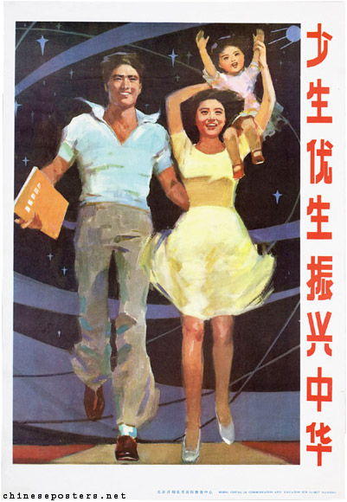
Poster 1
Notes:
1987, Less Births, better births, to develop China vigorously

Slide 7
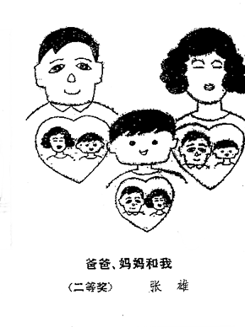
Poster 2

Slide 8
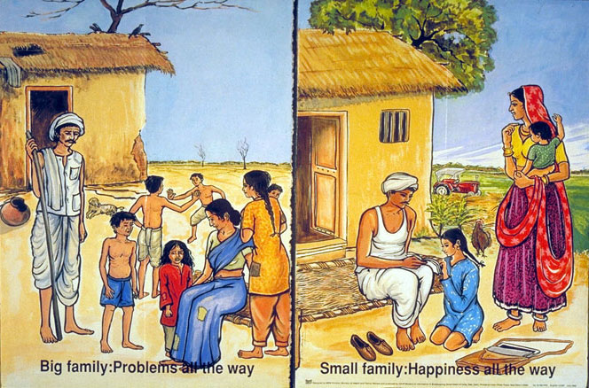
Poster 3

Slide 9
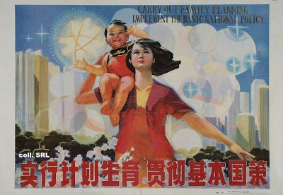
Poster 4
Notes:
Carry out family planning, implement the basic national policy, 1989

Slide 10
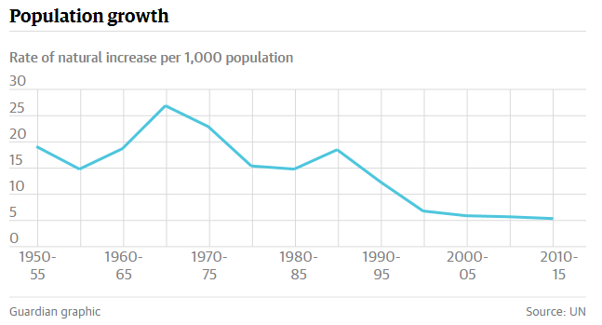
Why should China change their policy?
Population growth has slowed down

Slide 11
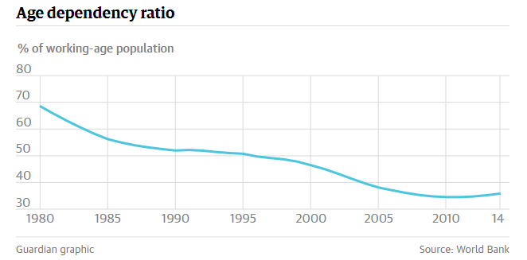
Why should China change their policy?
Working age is shrinking

Slide 12
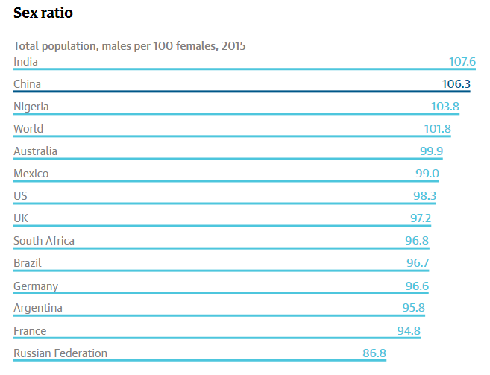
Why should China change their policy?
Gender imbalance

