Slide 1
Migration Factors
Day 5

Slide 2
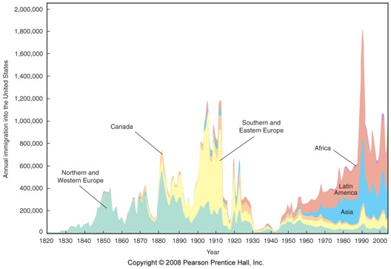

Slide 3
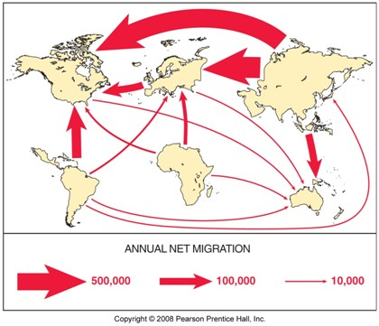

Slide 4
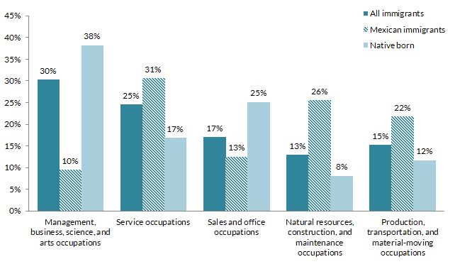

Slide 5
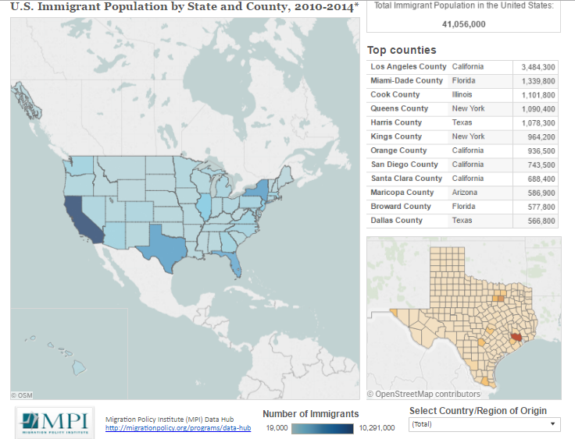

Slide 6
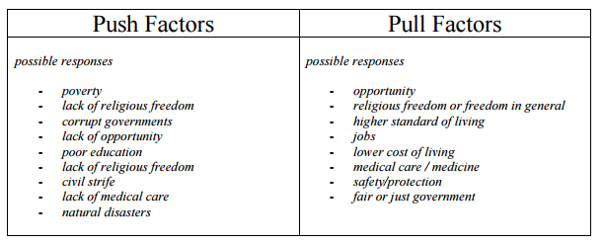

Slide 7
https://www.youtube.com/watch?v=rxF0t-SMEXA
https://news.vice.com/video/immigrant-america-murder-and-migration-in-honduras

