Slide 1
Lap 3
Memory and Thought
The Heart of Cognitive Psychology:
Mental processes and their effect on behavior

Slide 2
Memory:
Maintaining info over time
Memory is learning that has persisted over time
Our ability to store and retrieve information

Slide 3
Stages of Memory:
Input/ encoding, storage, retrieval of what has been learned or experienced

Slide 4
Stages of Memory:
Input/ encoding-
Senses recognize information sense specific!
Visual (iconic)- images/ pix or text
Auditory (acoustic)- principle for STM
Semantic- encoding by meaning- principle for LTM
<1 second, decide if it’s worth noting
“memory” begins

Slide 5
Stages of Memory:
Storage: retaining information
Three Stages-
Sensory
Short Term
Long Term

Slide 6
Three Stages of Storage:
Sensory Memory:
very brief, <1 second, little capacity
The longer the delay, the greater the loss**
Short Term/ Working or Active Memory:
Things in the conscious mind at any time
We are aware that we’re thinking about it
~30 seconds, ~7 items LIMITED
Long Term:
lifetime, unlimited!

Slide 7
Short Term Memory:
Info lost with distraction of passage of time
Stored and retrieved sequentially
Rehearsal- repetition
To hold in STM by repeating verbally 3 second experiment
Would rapidly decay with no rehearsal
limited duration!
Helps to transfer from STM to LTM
Chunking- grouping
To break down complex information
Increases working memory
1776149218121941
CIAFBITWAIBM
Acronyms- EGBDF
Mnemonics- memory aids use vivid imagery and organizational devices to aid memory recall

Slide 8
Long Term Memory:
Extended storage, inactive memory, unconscious mind, used when needed
Stored and retrieved by association with what we already know
Semantic- meaning of words, gen. knowledge
Store info about the world
London- Capital of GB, OR is north of CA… requires effort
Episodic- info about events
Ie: First day of school, 8th grade graduation
Procedural- learned skills/ muscle memory/ and motor skills
How to do things– ride a bike, play piano, tie shoes…

Slide 9
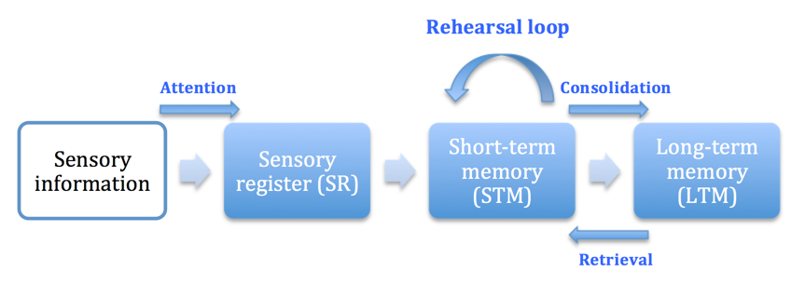
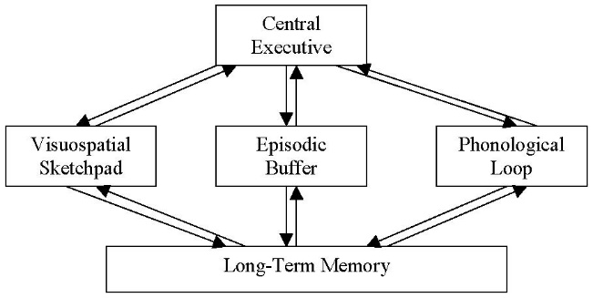
Long Term Memory:
Many theories on how each works
Clustered- categorized or arranged in groups
Multi-Store Model
Working Memory Model
Processing Theory:
Build on previous knowledge to aid memory and recall
Ie: put info in your own words or explain it to another student

Slide 10
Retrieval and Forgetting:
Forgetting- info cannot be retrieved
Repression- block embarrassing, frightening, unhappy memories
Amnesia- loss of memory, esp declarative knowledge
“know that-” episodic and semantic memories
Infant Amnesia- little remembered prior to age 3
A flood of info to process
Encoded and stored differently (no language!)
New memories interfere with the old

Slide 11
Retrieval and Forgetting:
Failure in any of the three stages
Decay- fade away of STM 3 second experiment
Displacement- STM has limited capacity
new info pushes out the old
Interference- blocked by other memory or confused with old info
Primacy- Recency Effect
Start strong, end strong!

Slide 12
Improving Memory
Elaborative Rehearsal- relate new info to what is already known
(Processing Theory)
The more senses used, more likely it will be retained– visual, audio, kinesthetic…
Over learn- rehearse things even after it is known
Cues and context

Slide 13
Recall
Reconstruction of info
For usage and problem solving
… Study Strategies

