Slide 1
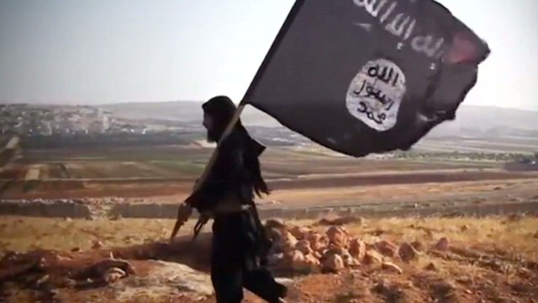
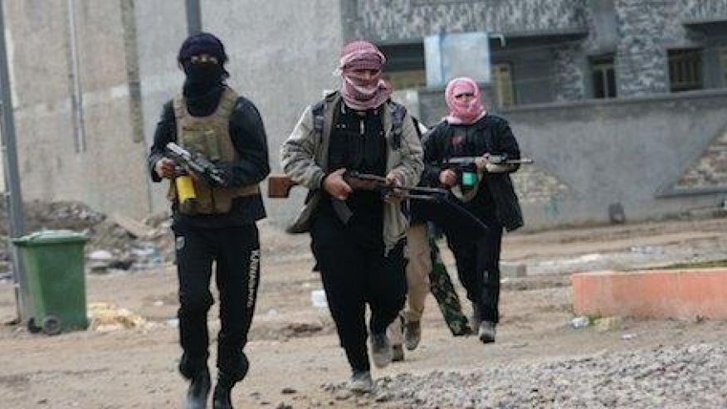
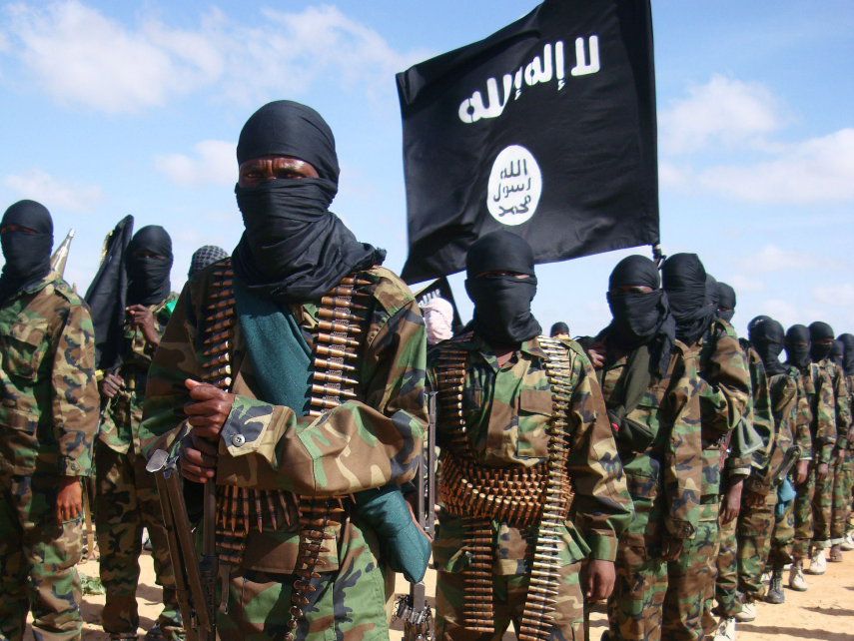
ISIS
https://www.neshaminy.org/site/handlers/filedownload.ashx?moduleinstanceid=7132&dataid=64717&FileName=ISIS%20PowerPoint%202017.pptx

Slide 2
WHAT IS ISIS?
ISIS IS A PRODUCT OF THE IRAQ WAR:
IT IS A NEW VERSION OF AL-QAEDA IN IRAQ (AQI), THE ISLAMIST GROUP THAT ROSE TO POWER AFTER THE AMERICAN INVASION.
AQI WANTED TO TAKE OVER TERRITORY INSIDE OF IRAQ BUT WAS DEFEATED IN 2006 BUT NOT DESTROYED.
IN 2011 THE GROUP RE-EMERGED AS ISIS AND SLOWLY BEGAN REBUILDING ITS STRENGTH.
ISIS STANDS FOR “THE ISLAMIC STATE OF IRAQ AND SYRIA”.
SOMETIMES IT IS CALLED ISIL WHICH STANDS FOR “THE ISLAMIC STATE OF IRAQ AND THE LEVANT”:
THE LEVANT IS THE REGION AROUND SYRIA WHICH INCLUDES SYRIA, LEBANON, ISRAEL, PALESTINE, AND JORDAN. THIS NAME SHOWS THAT THE MILITANTS WANT THEIR AREA OF CONTROL TO GO BEYOND IRAQ & SYRIA.
THE MILITANT GROUP ANNOUNCED IT PREFERS TO BE CALLED JUST “ISLAMIC STATE”.

Slide 3
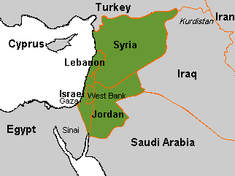
THE LEVANT

Slide 4
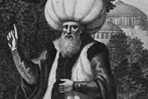
WHAT DOES ISIS WANT?
ISIS WANTS TO CARVE OUT AN ISLAMIC STATE IN IRAQ AND SYRIA.
THEY WANT COMPLETE FAILURE OF THE GOVERNMENTS IN IRAQ AND SYRIA SO A CALIPHATE CAN BE ESTABLISHED:
A CALIPHATE IS AN ISLAMIC STATE LED BY A CALIPH:
AN ABSOLUTE POLITICAL & RELIGIOUS LEADER
SUCCESSOR TO THE PROPHET MUHAMMAD

Slide 5
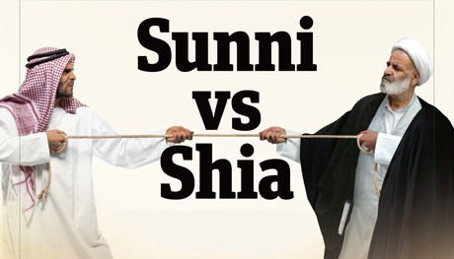
SUNNI VERSUS SHIA
ISIS THRIVES ON TENSION BETWEEN IRAQ’S TWO LARGEST RELIGIOUS GROUPS:
ISIS FIGHTERS ARE SUNNIS
MAJORITY OF IRAQIS ARE SHIAS
CIVIL WAR AFTER U.S. INVASION EMPOWERED THE SHIAS
TWO GROUPS DISTRUST EACH OTHER & COMPETE FOR CONTROL
SUNNIS FEEL THEY ARE PERSECUTED & THIS HELPS ISIS RECRUIT

Slide 6
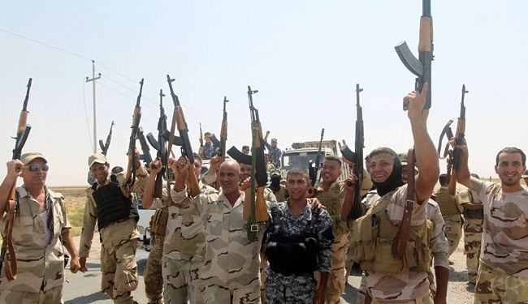
THE KURDS
IRAQ HAS ANOTHER ETHNO-RELIGIOUS GROUP, THE KURDS, WHO ARE IN THE FIGHT AGAINST ISIS:
KURDS ARE MOSTLY SUNNIS BUT ARE NOT ARABS
KURDS CONTROL PART OF NORTHEAST IRAQ
KURDISH MILITIAS REPRESENT A SERIOUS THREAT TO ISIS

Slide 7
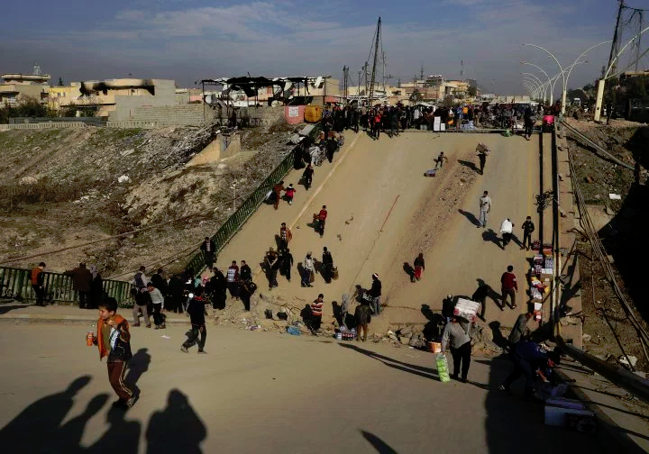
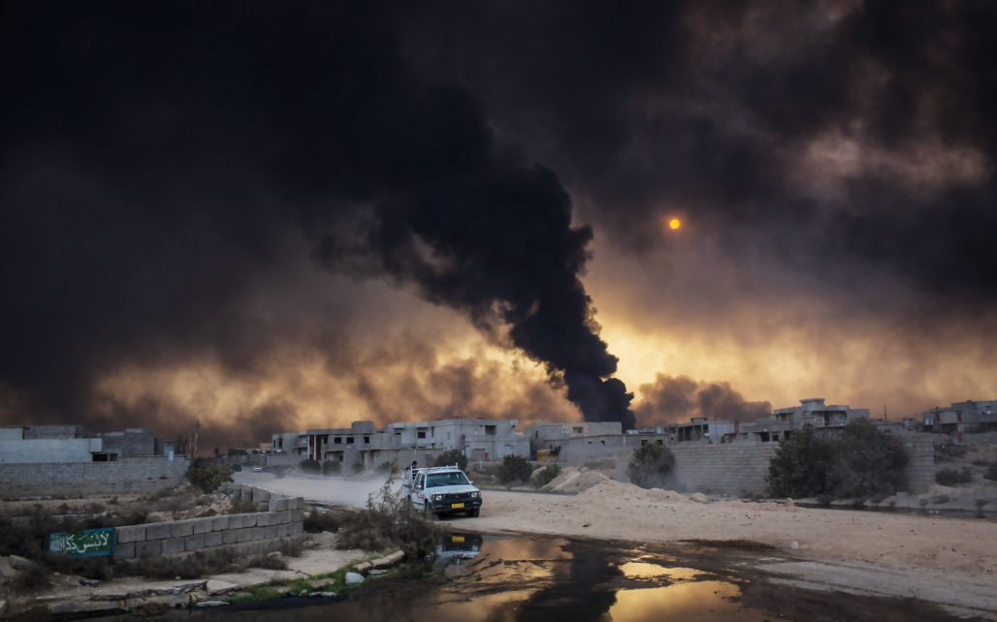
MOSUL
ISIS’ CAPTURE OF THE CITY OF MOSUL IN IRAQ WAS IMPORTANT AND ISIS SPREAD OUT FROM THERE:
MOSUL, THE 2ND LARGEST CITY IN IRAQ, IS CLOSE TO:
MAJOR OILFIELDS
KEY WATER SUPPLIES
ISIS CAPTURED MOSUL IN 2014
THE IRAQI ARMY, MILITIAS, & COALITION FORCES HAVE BEEN FIGHTING TO RETAKE MOSUL AND ARE MAKING PROGRESS

Slide 8
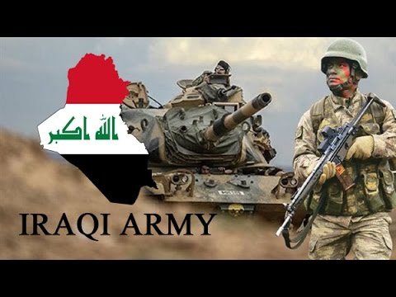
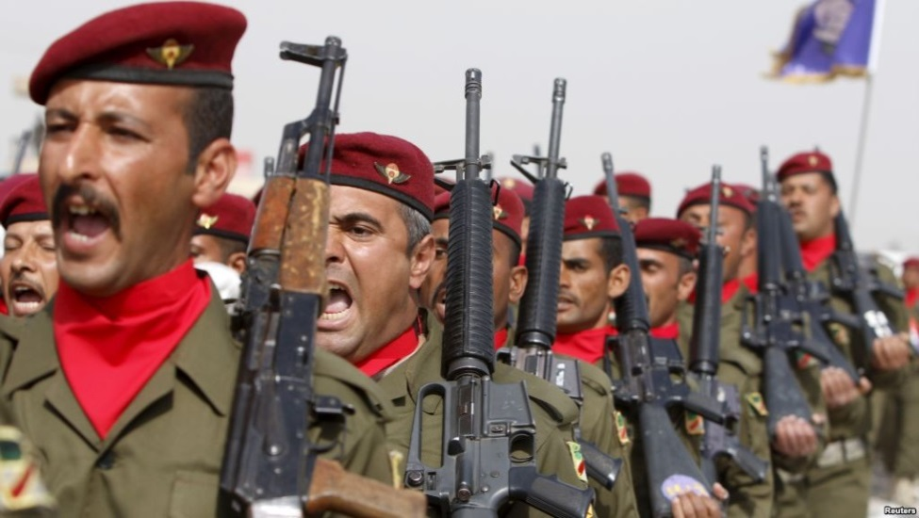
IRAQI ARMY
THE IRAQI ARMY IS MUCH LARGER THAN ISIS, BUT ALSO A MESS:
MORALE IS POOR IN IRAQI ARMY
IRAQI ARMY HAS BOTH SUNNI & SHIA TROOPS
SUNNI IRAQI SOLDIERS OFTEN DO NOT WANT TO FIGHT SUNNI ISIS FORCES

Slide 9
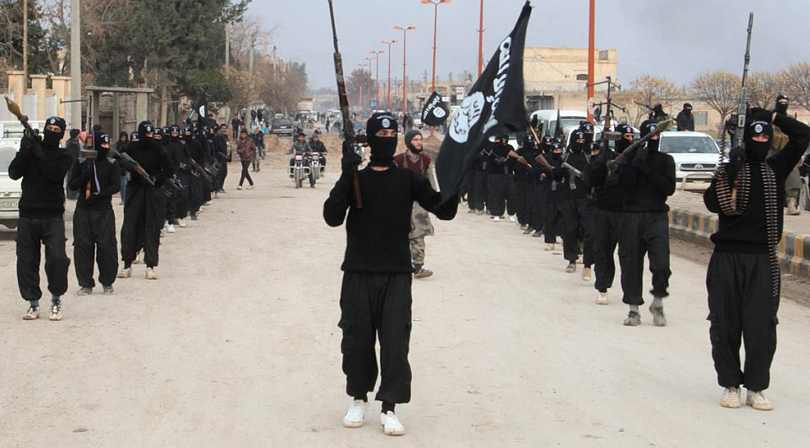
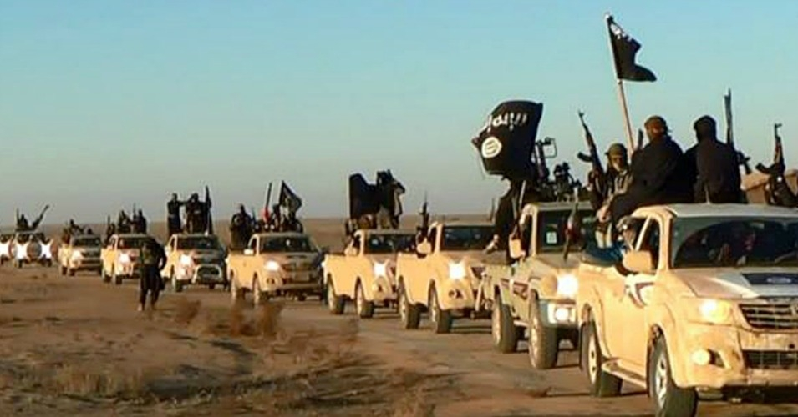
THE SYRIAN CONFLICT
THE SYRIAN CONFLICT HAS MADE ISIS MUCH STRONGER:
ISIS IS FIGHTING THE SYRIAN GOV’T (AS ARE OTHER GROUPS)
THE CRISIS IN SYRIA HAS HELPED ISIS’ ATTACKS IN IRAQ
ISIS AREAS IN SYRIA PROVIDE WEAPONS & MONEY
WHEN FIGHTING SYRIAN TROOPS ISIS CAN SAFELY RETREAT TO IRAQ AND VICE-VERSA

Slide 10
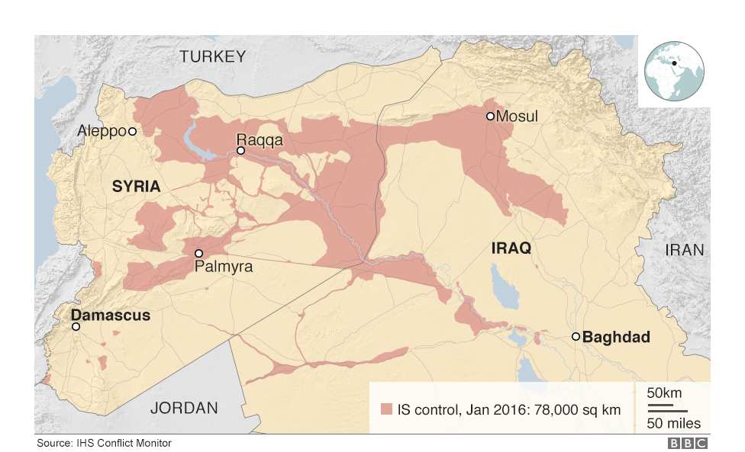
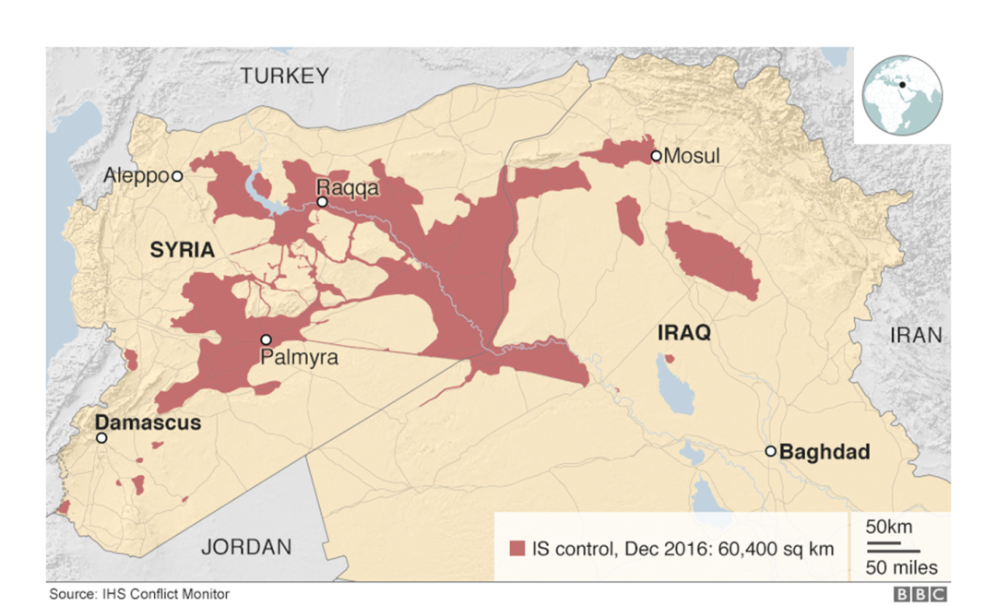
CURRENT SITUATION
OVER THE PAST YEAR ISIS HAS LOST NEARLY 25% OF THE TERRITORY IT CONTROLLED IN IRAQ & SYRIA
THE BATTLE FOR MOSUL CONTINUES:
IT IS EXPECTED THAT THE CITY WILL BE RECAPTURED IN THE COMING MONTHS
U.S. BACKED SYRIAN REBELS HAVE BEEN ADVANCING ON ISIS STRONGHOLDS
PRESIDENT TRUMP HAS VOWED TO DESTROY ISIS

Slide 11
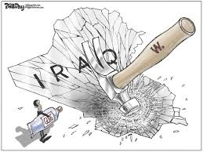
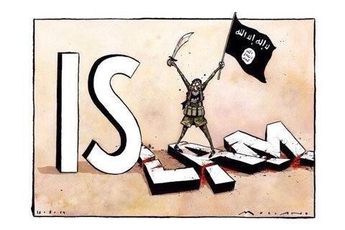
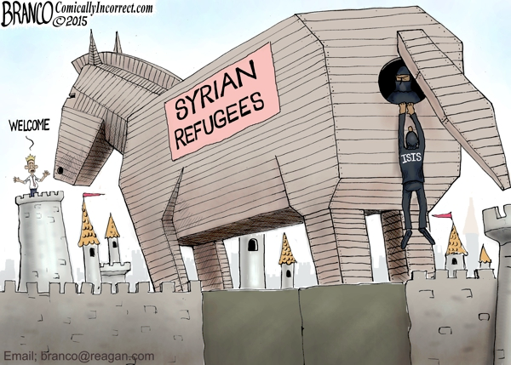
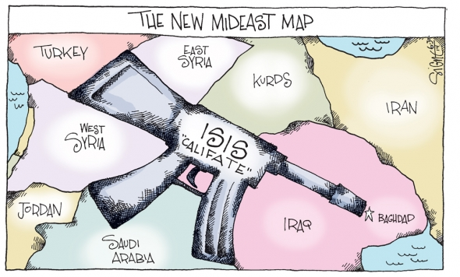

Slide 12
