Slide 1
Hinduism and Buddhism

Slide 2
Comparing Hinduism and Buddhism
How are the beliefs, practices, and effects on social order of Hinduism and Buddhism similar? How are they different?
Complete Graphic Organizer by reading the stations.
Complete the Venn Diagram and questions

Slide 3
Station One
What is Buddhism?
Belief system originated in India in the mid-400s BC.
Founded by Siddhartha Gautama, better known as Buddha (the Enlightened One)
Born a prince in 480 BC then devoted his life to finding answers to spiritual questions
Buddhists seek to reach a state of nirvana, following the path of the Buddha, Siddhartha Gautama, who went on a quest for Enlightenment around the sixth century BC.
Originated from a time and place that was dominated by Hinduism
376 million followers worldwide

Slide 4
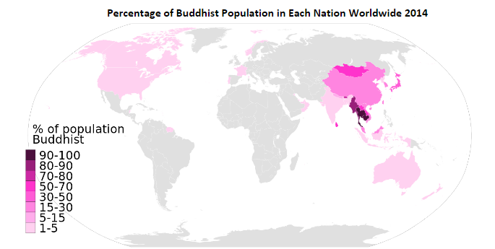

Slide 5
Station Two
Tripitaka- “Three Baskets of Wisdom”
The Tripiṭaka (Sanskrit), meaning "three baskets," is the formal term for the earliest surviving Buddhist teachings.
The teachings were passed down orally for around 200 years after the Buddha’s death before they were finally written down by Buddhist monks.
The Pali Canon falls into three general categories, or baskets, the first was the code of ethics to be obeyed by the early monks and nuns. The second category consists primarily of accounts of the Buddha's teachings. The third category contains early commentary on the Buddha’s teachings from his followers.

Slide 6
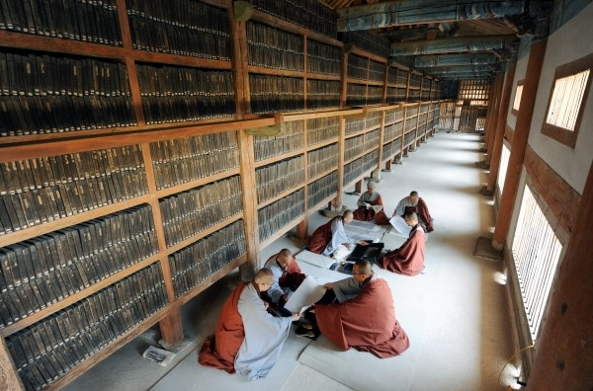

Slide 7
Station Three
Karma is a Sanskrit word from the root "Kri" to do or to make and simply means "action." It operates in the universe as the continuous chain reaction of cause and effect.
What we are, then, is entirely dependent on what we think. Therefore, the nobility of man's character is dependent on his"good" thoughts, actions, and words. At the same time, if he embraces degrading thoughts, those thoughts invariably influence him into negative words and actions.
The Buddha taught that the world as we experience it is impermanent and unsatisfactory, that there is a reason why we experience the world in this way, that there is a state of utter peace and contentment that can be experienced here and now, and that there is a way that leads to this state - in short, the Four Noble Truths.
Amongst the other key teachings that inform the Buddhist perspective is that of rebirth. The Buddha taught that we are born and reborn many times and that there are six realms of existence into which we can be reborn.
According to Buddhism, the best rebirth is that of a human being as it offers the best opportunity for gaining enlightenment. In the heavenly world, the gods are too absorbed in pleasure to make the necessary effort for spiritual realization. The other realms offer few opportunities for good actions and spiritual advancement.

Slide 8
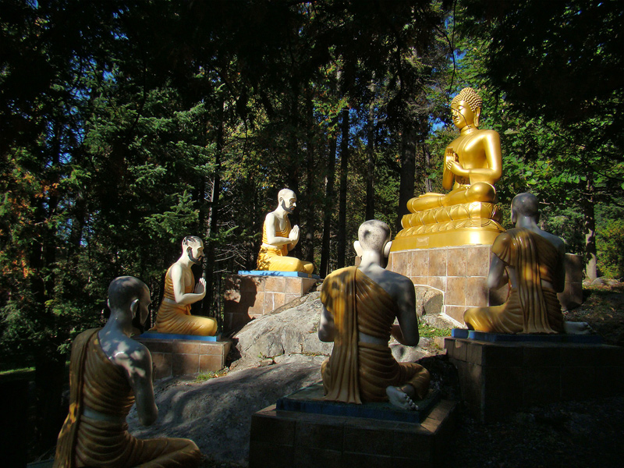

Slide 9
Station Four
Buddhism started in a region of the world where Hinduism dominated, but Buddha rejected a major part of Hindu society: the caste system.
Buddha taught that anyone, regardless of their place in society, could achieve enlightenment if they realized the Four Noble Truths and followed the Eightfold Path.
The Eightfold Path describes how one should act to eliminate desire and thus suffering. The Eightfold Path is the moral code of conduct for Buddhists.
Buddha taught four principles that he believed to be true. They are called the Four Noble Truths. Put simply they are:
The Noble Truth of Suffering: Life is suffering.
The Noble Truth of the Cause of Suffering: Suffering is caused by desire.
The Noble Truth of the Cessation [Stopping] of Suffering: To end suffering, one must end desire.
The Noble Truth of the Path: To end suffering, follow the Eightfold Path.

Slide 10
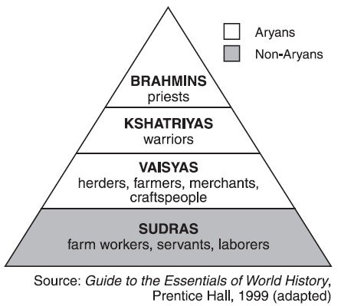
Aryans were nobles in ancient India and were believed to be descendants of a group that migrated into India around 1500 BCE. Some of the Aryan belief system was blended with Indian beliefs which contributed to creating Hinduism
Notes:
Print this for station four and five

Slide 11
Station Five
The Hindu Caste System is is a rigid social hierarchy. It is a system for grouping people in society. It is called “rigid” because you cannot leave whichever caste you are born into. There is no social mobility. Your caste determines your job, where you live, and who you can associate with. You can only move out of the caste through the process of reincarnation.
“…The fourfold division of castes was created by me [Vishnu] according to the apportionment [distribution] of qualities and duties….The duties of Brâhmins, Kshatriyas, and Vaisyas, and of Sûdras, too...are distinguished according to the qualities born of nature. Tranquillity, restraint of the senses, penance, purity, forgiveness, straightforwardness, also knowledge, experience, and belief (in a future world), this is the natural duty of Brâhmins. Valour, glory, courage, dexterity, not slinking away from battle, gifts, exercise of lordly power, this is the natural duty of Kshatriyas. Agriculture, tending cattle, trade, (this) is the natural duty of Vaisyas, And the natural duty of Sûdras, too, consists in service. (Every) man intent on his own respective duties obtains perfection.
Bhagavad Gita explaining the importance of caste-duty

Slide 12
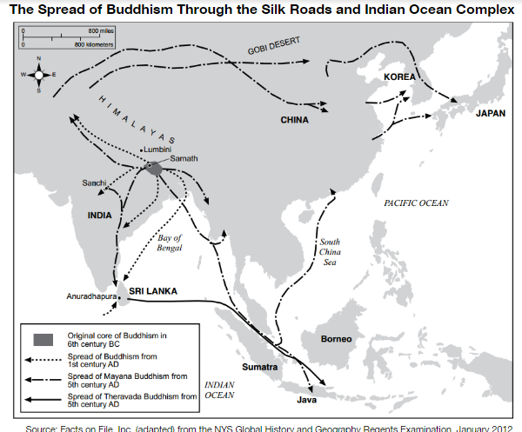

Slide 13
Station Six
Hinduism is a belief system that originated in the Indus River Valley. There is no single founder or date of the belief system’s creation because it is based on the beliefs and practices of a diverse group of people who added to the religion over thousands of years.
Hinduism’s sacred text is the Vedas, a collection of hymns and ritual texts that were compiled over a long period of time from different authors.
Hinduism is followed by the majority of people in India and Nepal, but it also exists among significant populations outside of the sub continent and has over 900 million followers worldwide.

Slide 14
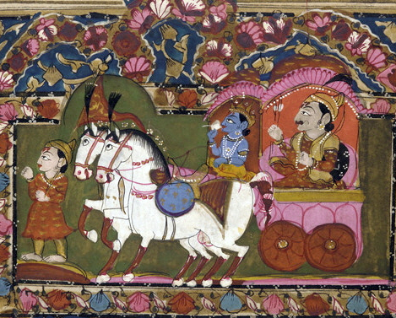
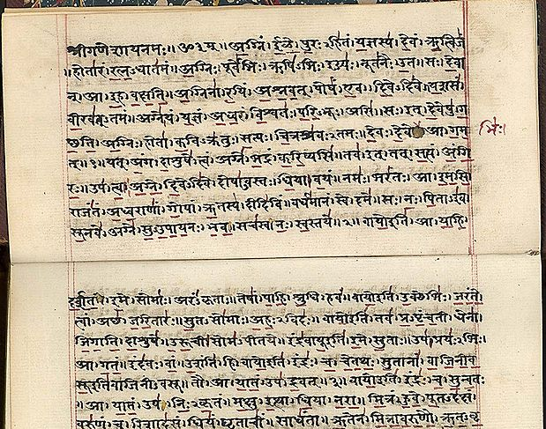
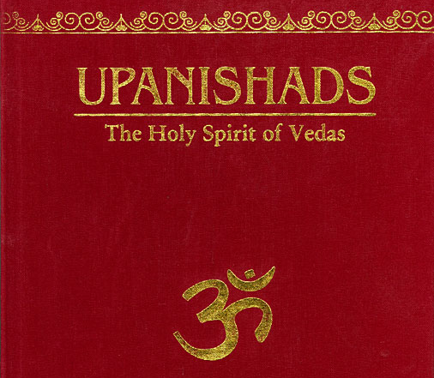
7
Rig Veda | The Upanishads | Mahabharata and Bhagavad Gita
Rig Veda in Sanskrit on paper, India, early 19th c. Source. | Cover of a modern publication of of the Upanishads. | Illustration of Krishna and Arjun on the chariot, Mahabharata, 18th-19th century, India. Source.
The Vedas are the most sacred texts in Hinduism. The Rig Veda is the oldest of the Vedas. It was written in Sanskrit at least 6,000 years ago. Vedic hymns (religious songs written in a Veda) praise god, gods, and goddesses and describe a powerful and spiritual people, their clans, kings and emperors, fights, battles, and way of life. Originally, these thousands of hymns were not written down but memorized. Even today there are priests who can chant from memory as many as 10,500 verses which takes 50 hours. | The Upanishads are sections of the Vedas that deal with philosophy, medication, and the nature of God; they form the core spiritual thought of Vedantic Hinduism. They are a compilation of dialogues, monologues and anecdotes composed by multiple authors, which contain the foundations for most of the later philosophies and religions of India. According to tradition, there are over two hundred Upanishads. | The Mahabharata is the world's longest epic. It is about a massive war in ancient India between cousins fighting for the throne of a great kingdom. A central episode called Bhagavata Gita is a dialogue between commander Arjuna and Lord Krishna on the day of the battle. The Mahabharata remains one of the most widespread scriptures in the world with its dominant message of justice. Hindu sacred music, dance, drama, and the arts draw heavily on these two literary epics.

Slide 15
Station 8
In Buddhism, there is no belief in a personal god. Buddhists believe that nothing is fixed or permanent and that change is always possible.
According to this branch of philosophy, the Devas or Gods are the more fortunate human beings, who also possess more powers than average human beings. According to Buddhism, the powers of these so-called Gods or deities are restricted, as they are only transitory beings.
Buddhism states that once these divine beings finish all their good karma, which they accumulated during their past birth or births, they leave their world and pass on from there, only to take a rebirth somewhere else, in accordance with their past karma, whether it be good or bad.
Unlike Hinduism, Buddhism does not place too much importance on specific Gods or godly figures. This philosophy does not consider Gods to uplifting humankind in any way, or offering them Nirvana or salvation, as Hinduism does. Also, it believes that both humans and deities are subject to Karma and the ensuing cycle of birth and death.

Slide 16
Station Nine

Slide 17
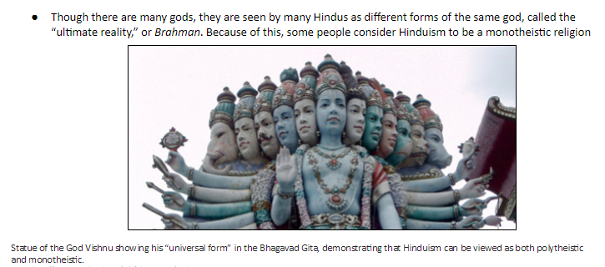
Station Nine (cont.)

Slide 18
10

Slide 19
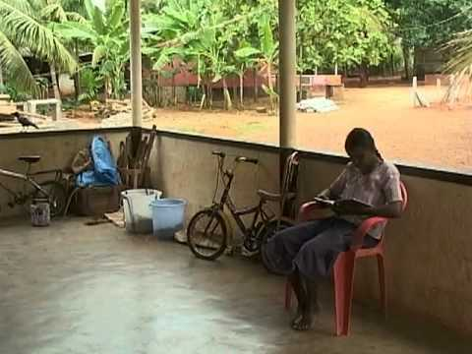
The Untouchables
List three “VIPs” from this video

