Slide 1
Intro to World History
Day 2

Slide 2
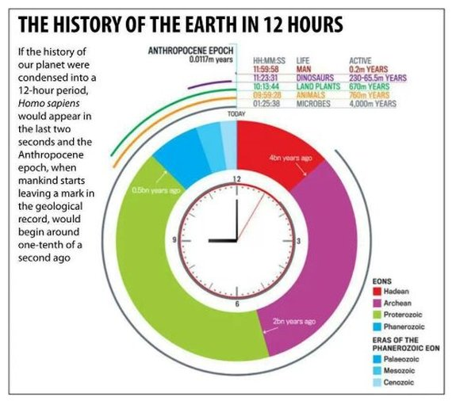
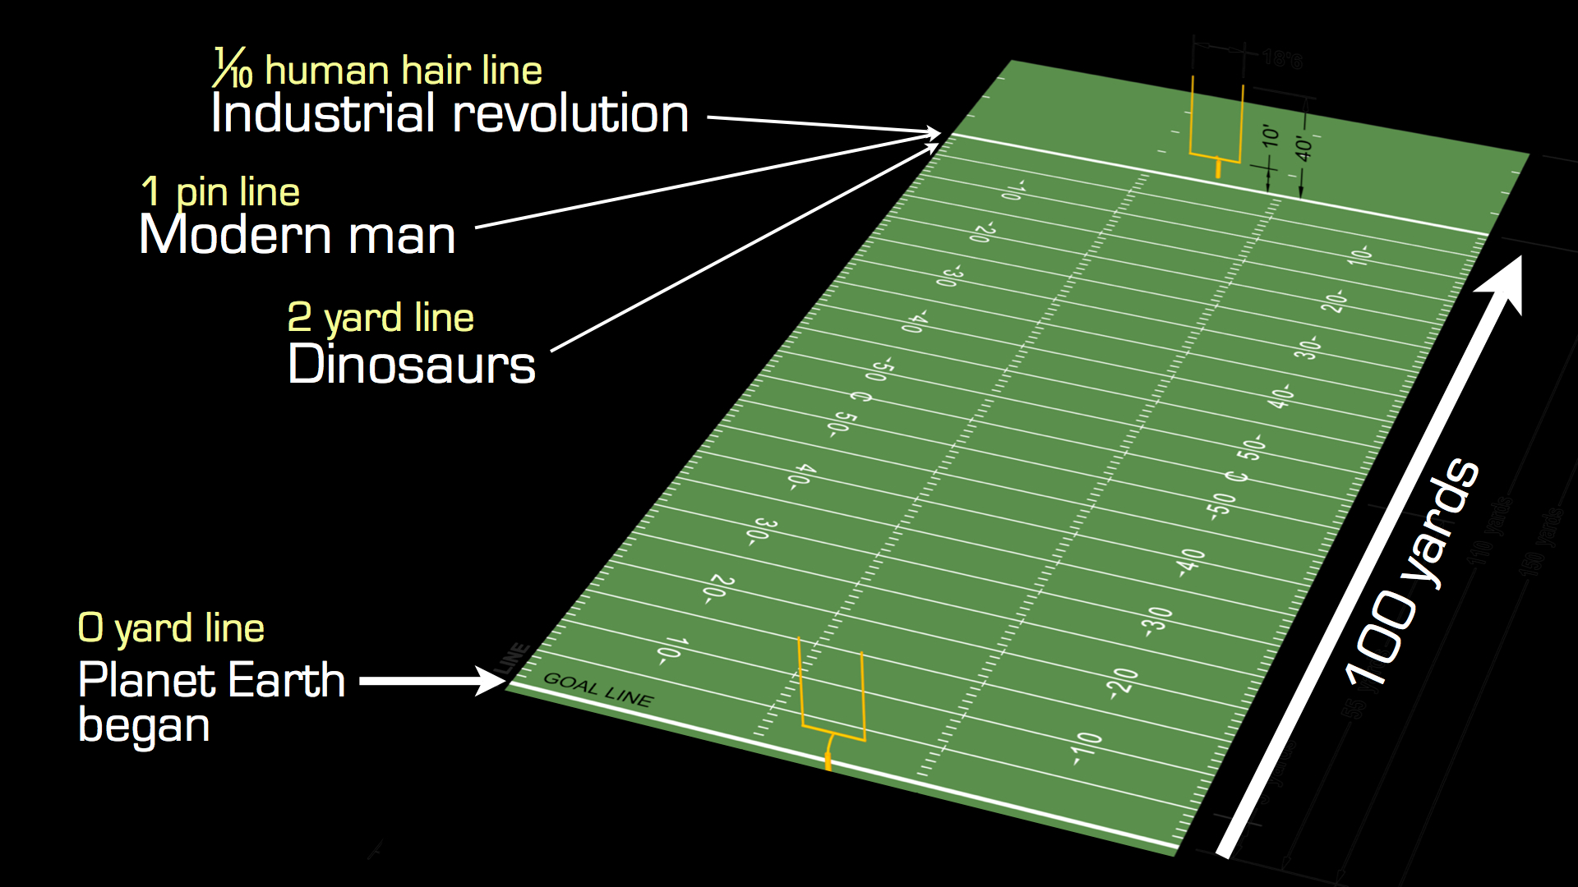
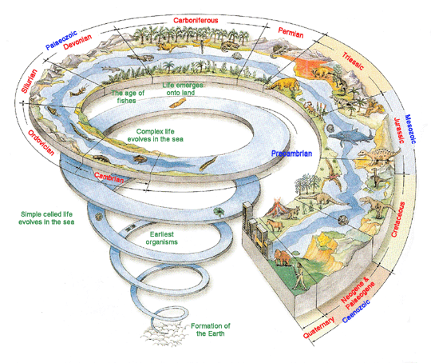
Evolutionary Timeline Spiral

Slide 3
Cosmic Calendar Activity
People have a lot of trouble envisioning the history of the universe, from the Big Bang, 13.7 billion years ago, to the present moment. In this activity you will equate the full span of cosmic time with one calendar year, and see where different cosmic events fall on a 12-month time scale.

Slide 4
Cosmic Calendar Directions
Go to Google classroom and copy the posted Cosmic Calendar
In groups of 2, brainstorm at least 10 important events that happened between Big Bang and now
Receive 18 events → place them in chronological order
Check your answers with Cosmic Calendar next slide→ how many did you get right?
Complete the “Predicted Date on Cosmic Calendar” column

Slide 5
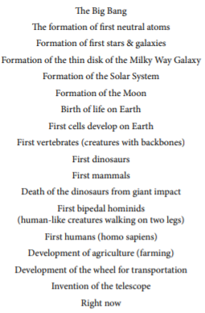
Cosmic Calendar

Slide 6
The Big Bang
Jan. 1, 12 am

Slide 7
The formation of first neutral atoms
Jan. 1, 12 :15 am

Slide 8
Formation of first stars and galaxies
Jan. 19

Slide 9
Formation of Milky Way
May 6

Slide 10
Formation of Solar System
Sep. 1

Slide 11
Formation of Moon
Sep 3

Slide 12
Birth of Life on Earth
Sep. 22

Slide 13
First cells develop on Earth
Nov. 9

Slide 14
First vertebrates
Dec. 18

Slide 15
First dinosaurs
Dec. 26

Slide 16
First mammals
Dec. 27

Slide 17
Death of the dinosaurs from giant impact
Dec. 30

Slide 18
First bipedal hominids
Dec. 31, 9:30 pm

Slide 19
First humans
Dec. 31, 11:52 pm

Slide 20
Development of agriculture
Dec. 31, 11:59:37 pm

Slide 21
Development of agriculture
Dec. 31, 11:59:45 pm

Slide 22
Development of the wheel
Dec. 31, 11:59:58 pm

Slide 23
Invention of the telescope
Dec. 31, 11:59:59 pm

Slide 24
Right now
Dec. 31, 11:59:59 pm

Slide 25
Writing Prompt: Google Doc answer the following in complete sentences→
How did this Cosmic Calendar Activity add to your understanding of World History. Give three examples. Submit assignment to Googleclassroom.

Slide 26
January

Slide 27
February

Slide 28
March

Slide 29
April

Slide 30
May

Slide 31
June

Slide 32
July

Slide 33
August

Slide 34
September

Slide 35
October

Slide 36
November

Slide 37
December

