Slide 1
Cultural Diversity of Africa
Day 2

Slide 2
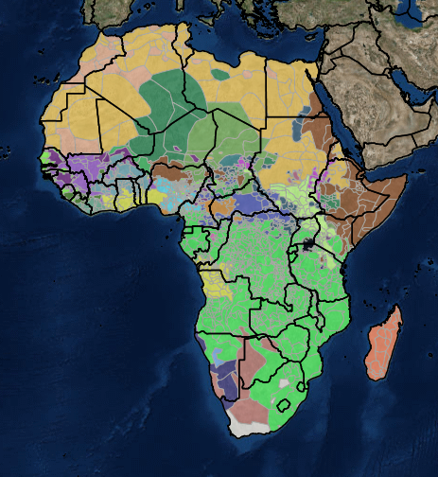
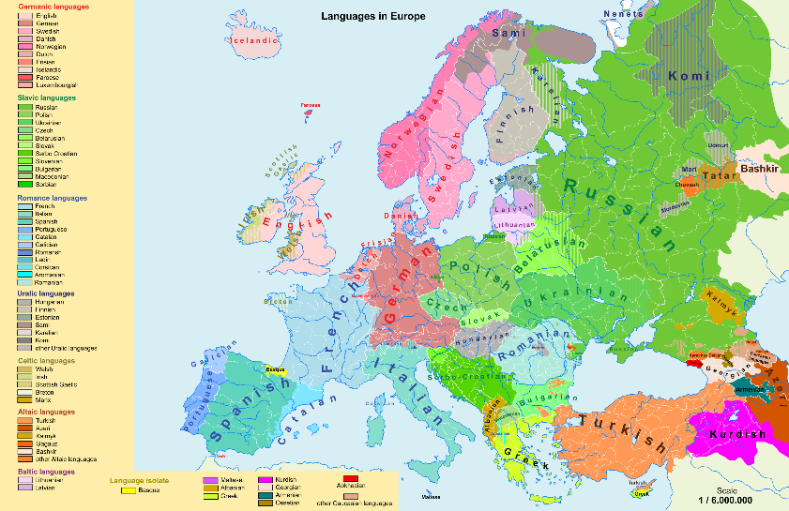
The colors in the maps represent the major languages of the country
Slide 1

Slide 3
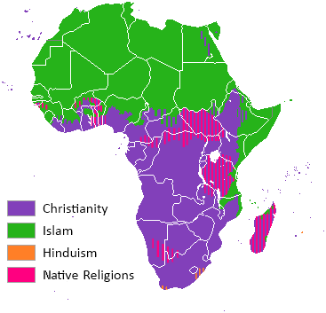
Slide 2
Country | Some Names for God
Angola | Kalunga, Nzambi, Suku
Botswana | Modimo, Urezhwa
Burundi | Imana
Cameroon | Njinyi, Nyooiy
Congo | Akongo, Arebati, Djakomba, Katshonde, Kmvoum, Leza, Nzambi
Cote D’Ivoire | Nyame, Onyankopon
Ghana | Bore-Bore, Dzemawon, Mawu, Nyame, Onyankopon
Ethiopia | Arumgimis, Igziabher, Magano, Tel, Yere, Yere Siezi
Kenya | Akuj, Asis, Mulungu, Mungu, Ngai, Nyasaye, Tororut Lesotho Molimo
Liberia | Yala
Madagascar | Andriamanitra, Zanahary
Malawi | Cauta, Chiuta, Leza, Mulungu, Unkurukuru
Mozambique | Mulungu
Namibia | Kalunga, Mukuru, Ndjambi, Karunga, Pamba
Nigeria | Ondo, Chuku, Hinegba, Olodumare, Olorun, Osowo, Owo, Shoko
Rwanda | Imana
Sierra Leone | Leve, Meketa, Ngewo, Yatta
South Africa | Inkosi, Khuzwane, Modimo, Mwari, Raluvhimba, Ukulunkulu, Utixo
Sudan | Ajok, Jok, Katonda, Kiibumba, Ori, Rugaga, Ruhanga, Wari
Swaziland | Mkulumncandi, Umkhulumncandi
Tanzania | Enkai, Ishwanga, Kyala, Kyala, Kyumbi, Mulungu, Mungo, Ruwa
Uganda | Akuj, Jok, Katonda, Kibumba, Ori, Rugaba, Ruhanga, Weri
Zambia | Chilenga, Chiuta, Lesa, Mulungu, Nyambe, Nzambi, Tilo
Zimbabwe | Mwari, Unkulunkulu, Nyadenga

Slide 4
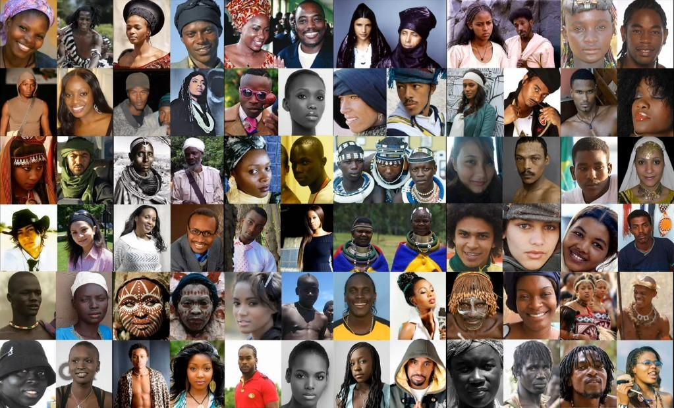
Slide 3

