Slide 1
Climate Zones of Africa
Day 1

Slide 2
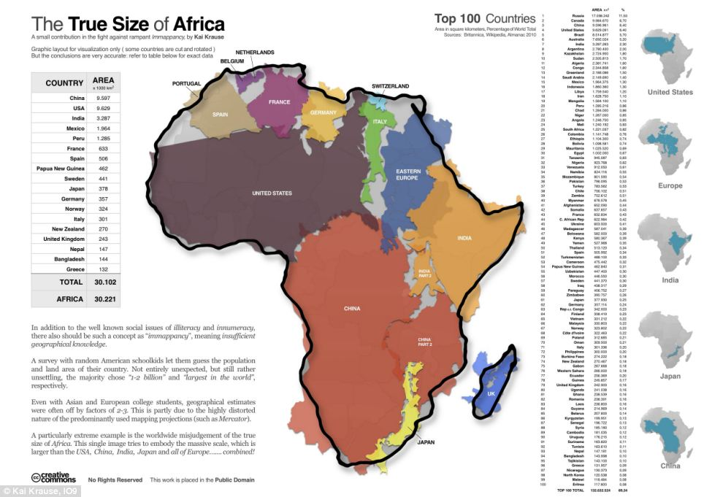

Slide 3
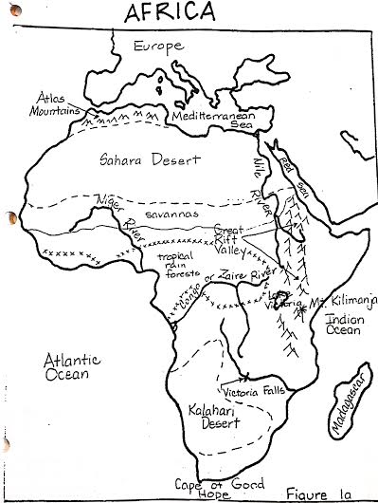
Desert
Little rainfall and sparse plant life
10 inches of rain a year
Lowest population densities
Sahara Desert and Kalahari Desert

Slide 4
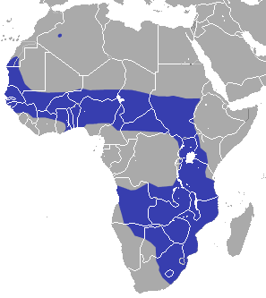
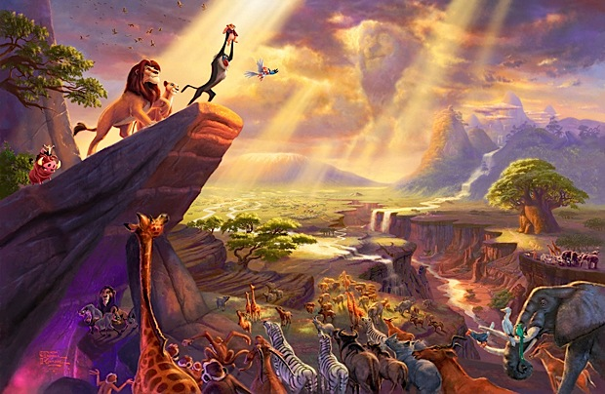
Savannas
Tropical grasslands
Wet and Dry Seasons
Wet—Summer
Plants and animals flourish
Dry--Winter
Plants die and rivers dry up

Slide 5
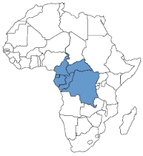
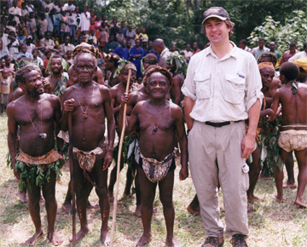
Rainforest
Wettest climate region (60 inches)
Rain falls daily

Slide 6
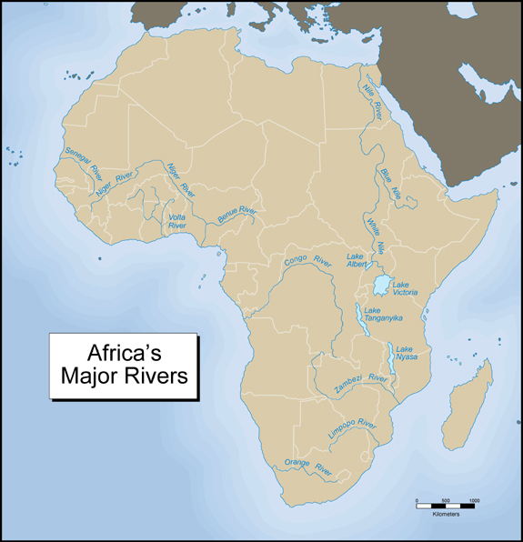
Bodies of Water and Freshwater
Rivers, Seas, Lakes, and Oceans
High Population Densities around water
People want a constant supply of water
Trade
Rich Soils
Irrigation
Fishing

Slide 7
https://www.youtube.com/watch?v=NzKejJIwieE
You will watch a video of the settlement of Africa from the 50th Century BCE to 2016
When we pause the video, star the areas on your map where civilizations arose
What would be the best place to live? Why?
What would be the worst place to live? Why?

