Slide 1
“Middle East Boundaries of the Past” Project
https://www.youtube.com/watch?v=66zFTVfXAls

Slide 2
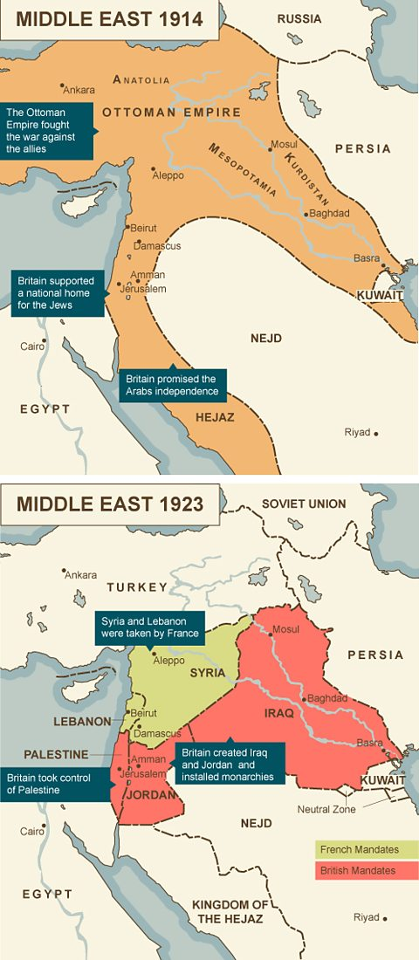

Slide 5
Groups for Athens
Ottoman Empire
Mykia, Kelly, and Miya
Byzantine Empire
Imani, Shamiya, and Grace
Abbasid Caliphate
Alyssa, Rachel, and Kelly-Ann
Fatimid Caliphate
Maggie, Michelle, and Celia
Umayyad Caliphate
Sammi, Yen, and Marisa

Slide 6
Groups for Cairo
Ottoman Empire
Alex, Madi, and Soledad
Byzantine Empire
Courtney, Lily, and Haley
Abbasid Caliphate
Hannah, Jenna, and Meghan
Fatimid Caliphate
Emma, Lizzy, and Camille
Umayyad Caliphate
Morgan, Paige, and Liv

Slide 7
Groups for Havana
Ottoman Empire
Kaidy, Erin, Lauren L., and Christian
Byzantine Empire
Fiona, Drew, Carly, Abby, and Riley
Abbasid Caliphate
Paige, Alli, Payton, and Madisyn
Fatimid Caliphate
Courtney, Nina, Nyrah, and Rickie
Umayyad Caliphate
Gabby, Abby, Maria, and Lauren Y.

Slide 8
Next class will be a work day NOT a free day
You will be completing any additional research
You will be creating the Poster together
Preparing to present on the next day
What you need for next class:
YOUR research started or completed—checked for a grade
Poster Board
Glue/Tape
Markers

