Slide 1
1. 1979: The Beginning of The War
Soviet forces gradually began to land in Kabul, Afghanistan. December 25, 1979
On December 27, after crossing the border, the soviet army overthrows the afghan government and kills the president Hafizullah Amin , and the PM/Minister of defense Hafizullah Main
As part of Truman doctrine, President Carter Approves military Aid to Anti-Soviet Forces in Afghanistan

Slide 2
2.
On February of 1980, many afghans had protested against the soviet’s occupation in Kabul. However, hundreds have ended up being killed or arrested. The anti-soviet riot in Shindadnd was turned down due to the soviet forces
Osama bin Laden began to provide financial, organizational, and engineering aid for the mujahedeen in Afghanistan

Slide 3
3. 1985: rebel organizations formed
Seven party mujahideen alliance is formed in order to fight aginst the soviet

Slide 4
4. 1988: Yhe birth of al-Qaeda
August 11, 1988, bin laden stated in his meeting that the purpose of the meeting was to, “the establishment of a new military group,”

Slide 5
5. The end
On February 15, 1989 the soviet’s withdrew its army after 115,000 Soviet soldiers begin to move out after losing an estimated 15,000 troops in ten years as the result of their fight with the anti-communist group. mujahideen alliance

Slide 6
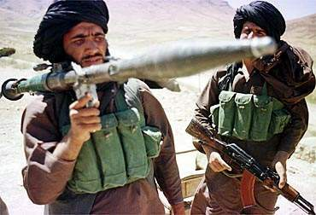
1950 - 1979
Pakistan and Afghanistan come close to war over disputed lands.
Government instability leads to frequent riots and overthrows.
Daoud Khan and the Communist Afghan Party seize power and the Republic of Afghanistan is born in 1973. Internal problems with this party cause Daoud to be killed.
Mass arrests, tortures and violence become common place in Afghanistan.
The Afghan guerrilla group (Mujahideen) formed to fight and resist government that was backed by Communist Russia.
Mass killings and the murder of the U.S. Ambassador. Many human rights violations.
Mujahideen Freedom Fighters

Slide 7
1980 - 1994
Soviet Union invades Afghanistan with thousands of troops to support the government in its struggle with the holy warriors called Mujahideen.
Five million Afghan refugees flee to Pakistan and Iran.
The Soviets with superior weapons could not defeat the guerrilla tactics of the rebels.
In 1988 the Soviets began withdrawing its troops from Afghanistan.
Fighting between the government and the Mujahideen continued until 1992 when the rebels overthrew the government.
Fighting among the factions prevented the formation of a stable government.
By the late 1990’s a Islamic group known as the Taliban had taken control of most of Afghanistan and set up a Council of Ministers to rule the country.

Slide 8
1994 - 1999
The Taliban movement was formed in Kandahar in 1994 by Islamic students who take a radical approach to interpreting Islam. The Taliban captured Kabul in September 1996 from Mujaheedin regime. The government of Burhan-ul Din Rabani ousted. The Taliban government in Kabul has been recognized only by Pakistan, Saudi Arabia and United Arab Republic. The Taliban regime strongly have been supported by Pakistani military regime. Anti-Taliban factions still hold about 15 percent of the country in the northern parts of Afghanistan. The United Nations and other international communities condemn the Taliban regime because of its violation of human rights, particularly restrictions of women from outside work and freedom. On October 10, 1999, the United States government declare political and economical sanctions against the Taliban regime in Afghanistan because of holding and supporting Saudi billionaire Bin Laden. October 25, 1999, Taliban offer talks between Afghanistan and the US Government including the future of Osma Bin Laden. October 28, 1999. Saudi Millionaire declared his desire to leave Afghanistan November, 5, 1999: Bin Laden likely stay in Afghanistan

Slide 9
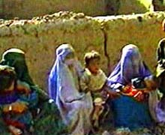
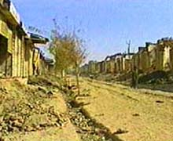
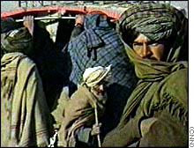
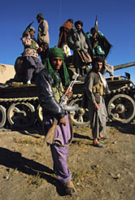
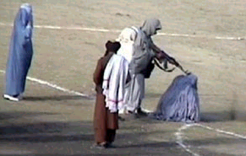
Taliban Rule
Between fighting, refugees have returned to homes burned and destroyed by the Taliban.
The United Nations has accused the Taliban of burning homes and crops to keep Afghan refugees from returning home.
Taliban isolated Afghanistan from the world
The Taliban
Taliban Justice

Slide 10
2000 - Today
Mohammed Omar, Taliban leader, continues to give aid and comfort to the terrorist Bin Lauden.
September 11, 2001. Al Qaeda forces of Bin Laden attack the United States.
United States and her allies declare war on terrorism.
Taliban Government driven into hiding, many Taliban and Al Quaeda forces killed or captured by the United States and her allies.
The Taliban grip on Afghanistan and support for Bin Laden has ended.
The War on Terrorism continues.

